Slide 1
Professional Development during your PhD

Slide 2
Why focus on Professional Development?
Develop as an effective, well rounded researcher
Competitive PhD graduate market
More informed decisions around career development
Develop a more focused and strategic approach
Notes:
Development as a professional involves more than building your research profile and research skills, to your own skills, understanding, aptitudes and ambitions.
To some extent you will work on these areas naturally during your PhD, you have a gap in your knowledge therefore read more papers discuss with colleagues, research is unfocused dedicate some time strictly to planning. Being conscious of it will help you to be more focused, keep a record and develop in a systematic way.
Competition for posts and use of short-term contracts mean that researchers have to be flexible and adaptable about what they can do. Focusing on your professional development can help you to:
Get the most from your current role or studies
Create a stronger profile for applications, whether for funding, promotion or a new post
Time spent thinking about your own values, strengths and areas to develop is time well spent as well as being informed about the requirements of different careers.
Being a successful researcher requires you to think strategically about your objectives, skills and areas to develop. Plan your development as you would your research.

Slide 3
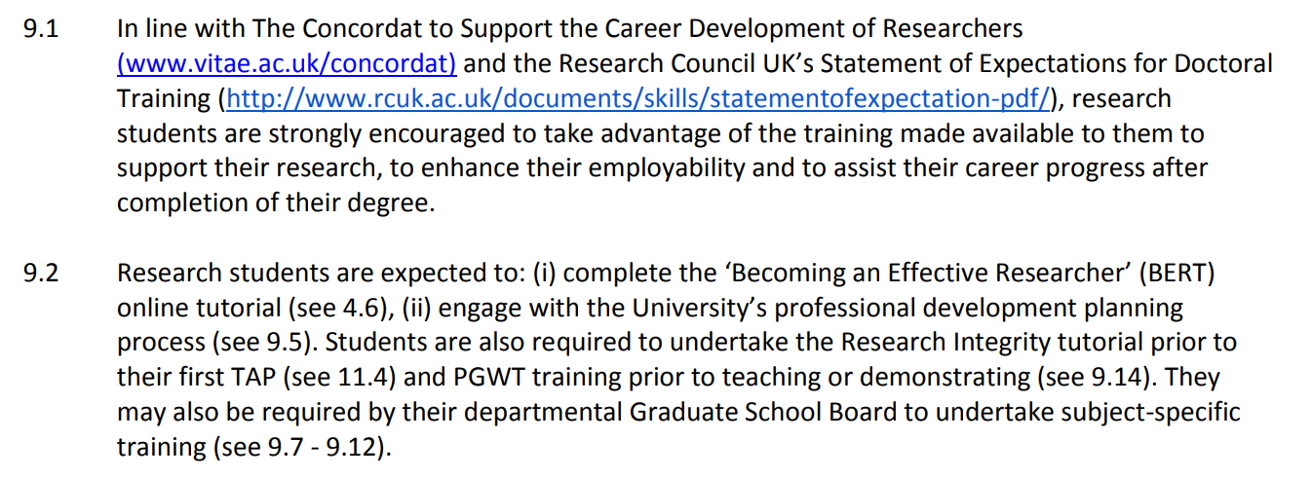
Notes:
As part of your research programme you should undertake 10 days a year of skills training

Slide 4
In your group discuss:
What areas of skills training have you been involved in so far during your PhDs
Where do they feel you have gaps in skills
What training would you like to do during your PhD?
Notes:
Last question – write on a post-it note and collate

Slide 5
What training do I need to do?

Slide 6
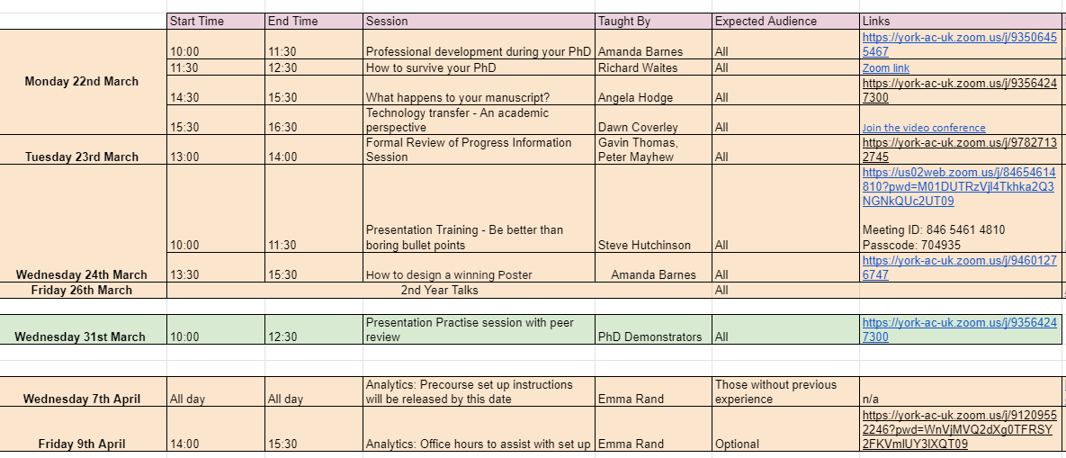
Year 1: Poster Presentation (May 20th)
Year 2: Second Year Talk (March)
Final Year: Final Year Talk (May)
Approximately 10 days a year should be spent on skills development and training

Slide 7
Which skills do I need to develop?

Slide 8
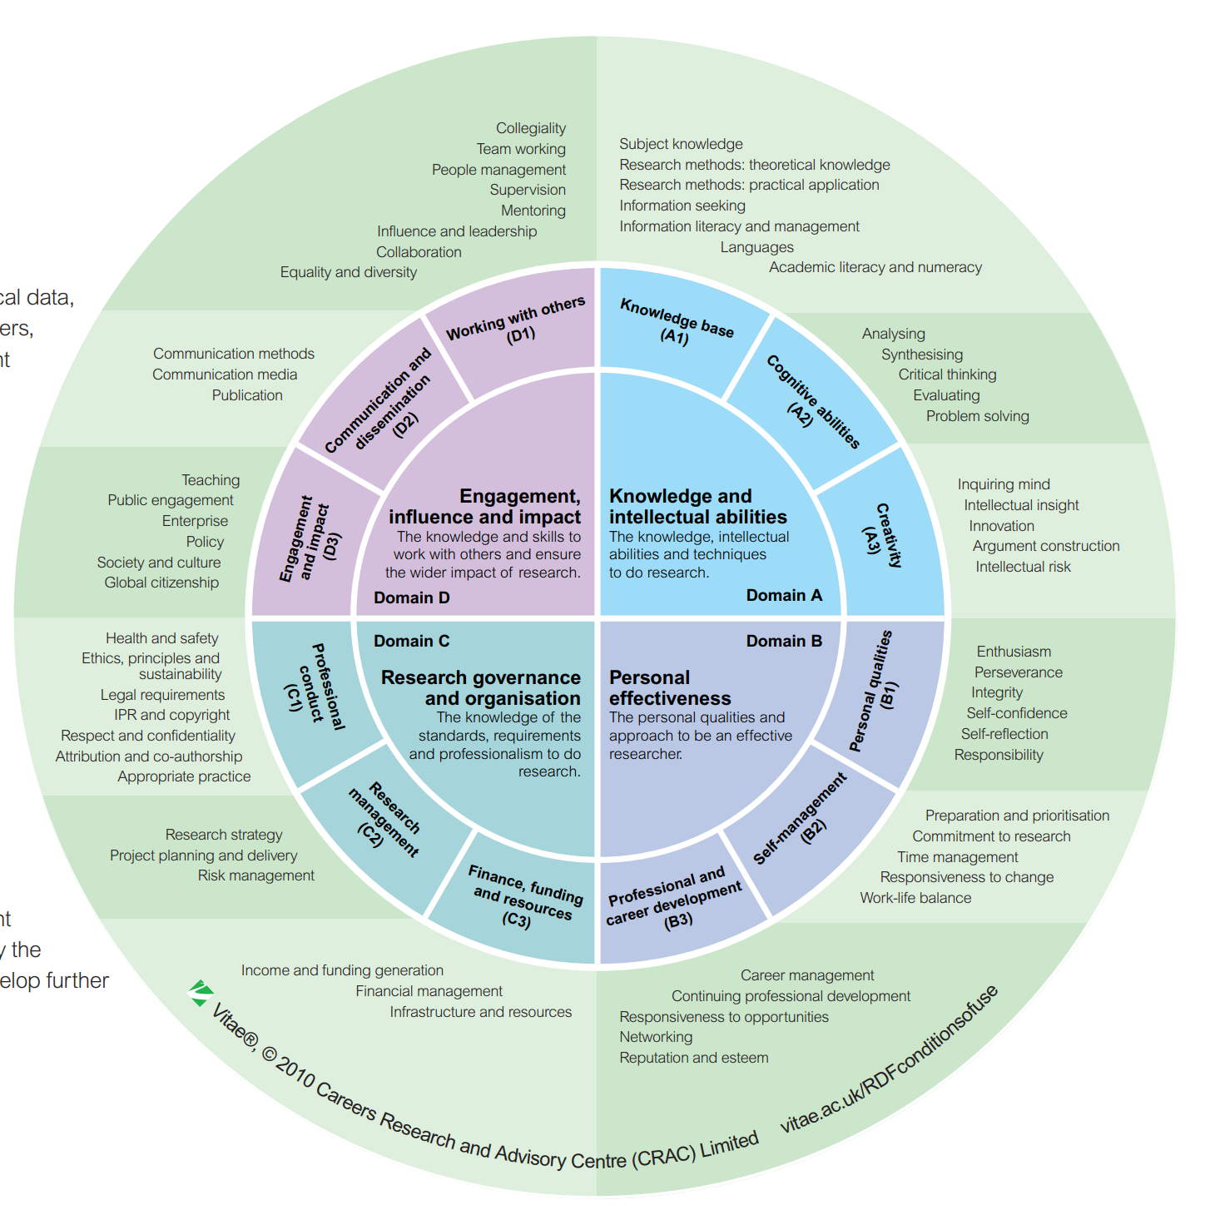
Vitae Researcher Development Framework
Approximately 10 days a year should be spent on skills development and training
Notes:
The Vitae Researcher Development Framework articulates the knowledge, behaviours and attributes of researchers.
It contains descriptors that are characteristics of effective researchers, divided into four domain areas.

Slide 9
Year 1 Autumn
Project specific activities
General scientific training
Technical training
Demonstrating
Outreach
Tours and Student support
Quality of the Research Process
Ethics
Managing yourself, PhD and data
General, Biological and Chemical safety awareness
Notes:
The training you have had so far aligns to different areas of the researcher development framework

Slide 10
Year 1 Spring
Be better than boring bullet points
How to present your poster
Oral presentation skills
Technology Transfer
Project specific activities
General scientific training
Technical training
What happens to your manuscript?
Be better than boring bullet points
How to present your poster
Notes:
The training you have had so far aligns to different areas of the researcher development framework

Slide 11
What areas might I need to develop?
Examine the job roles that PhD graduates could apply for
What gaps might you/ a PhD graduate have in their skills set?
Prepare examples an applicant could use to show their skills

Slide 12
How is my skill
development tracked?

Slide 13
A completed professional development plan is required for your formal review of progression

Slide 14
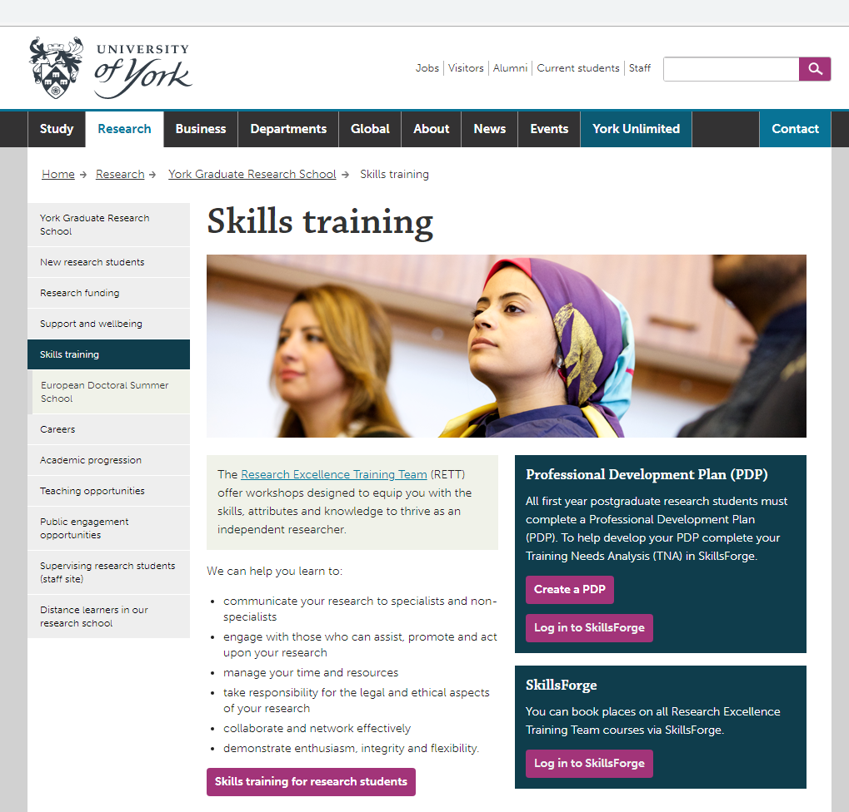
https://www.york.ac.uk/research/graduate-school/skills/

Slide 15
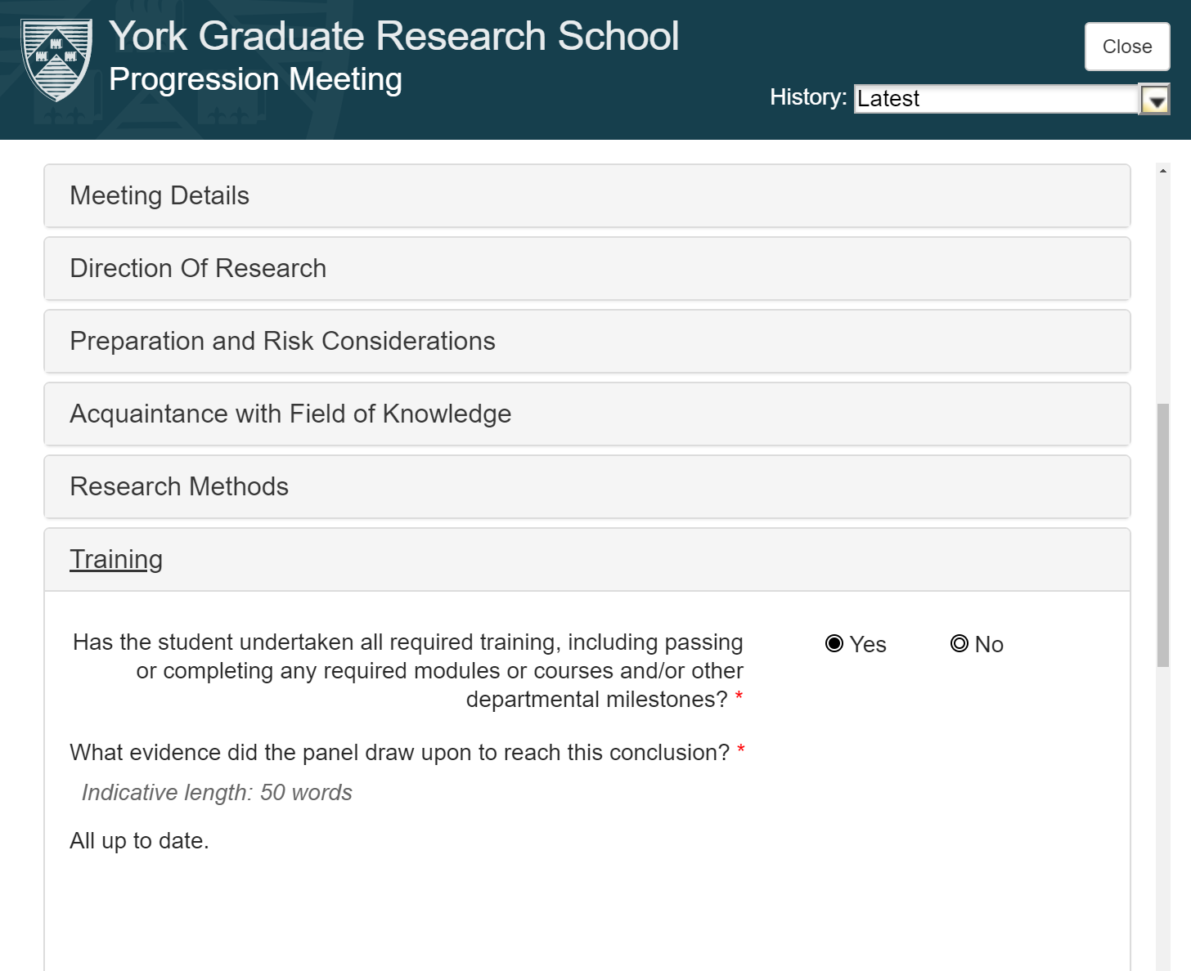
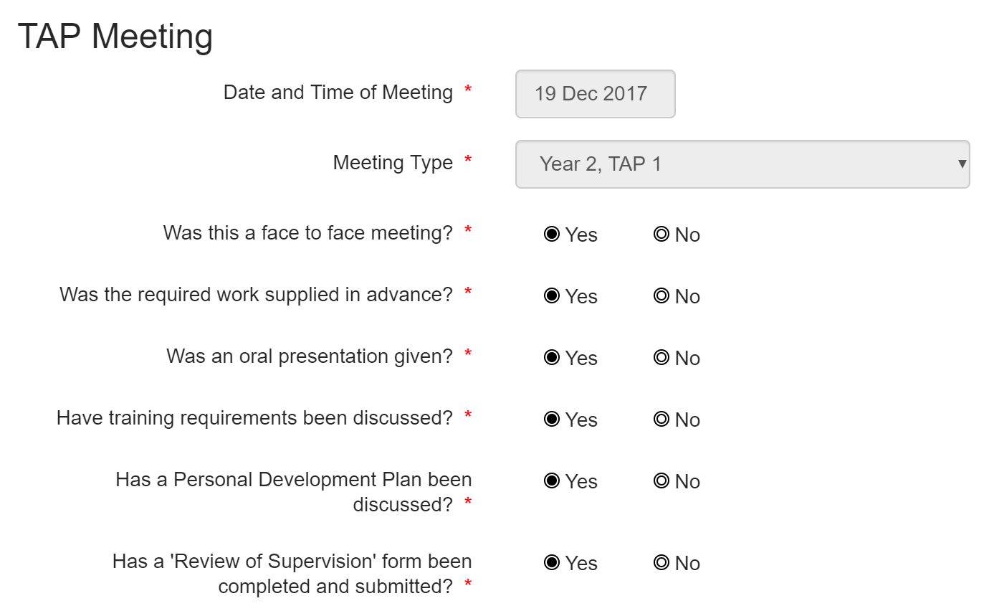

Slide 16
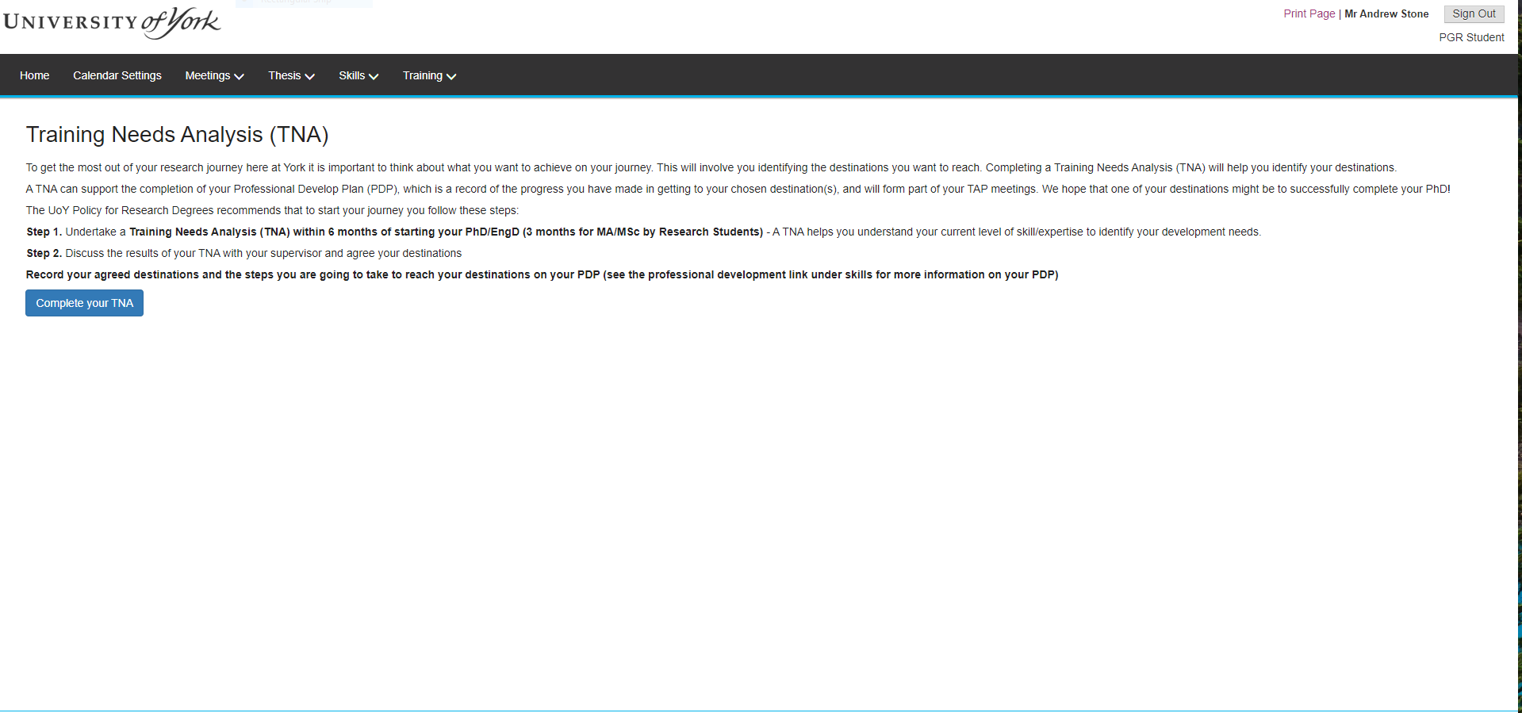

Slide 17
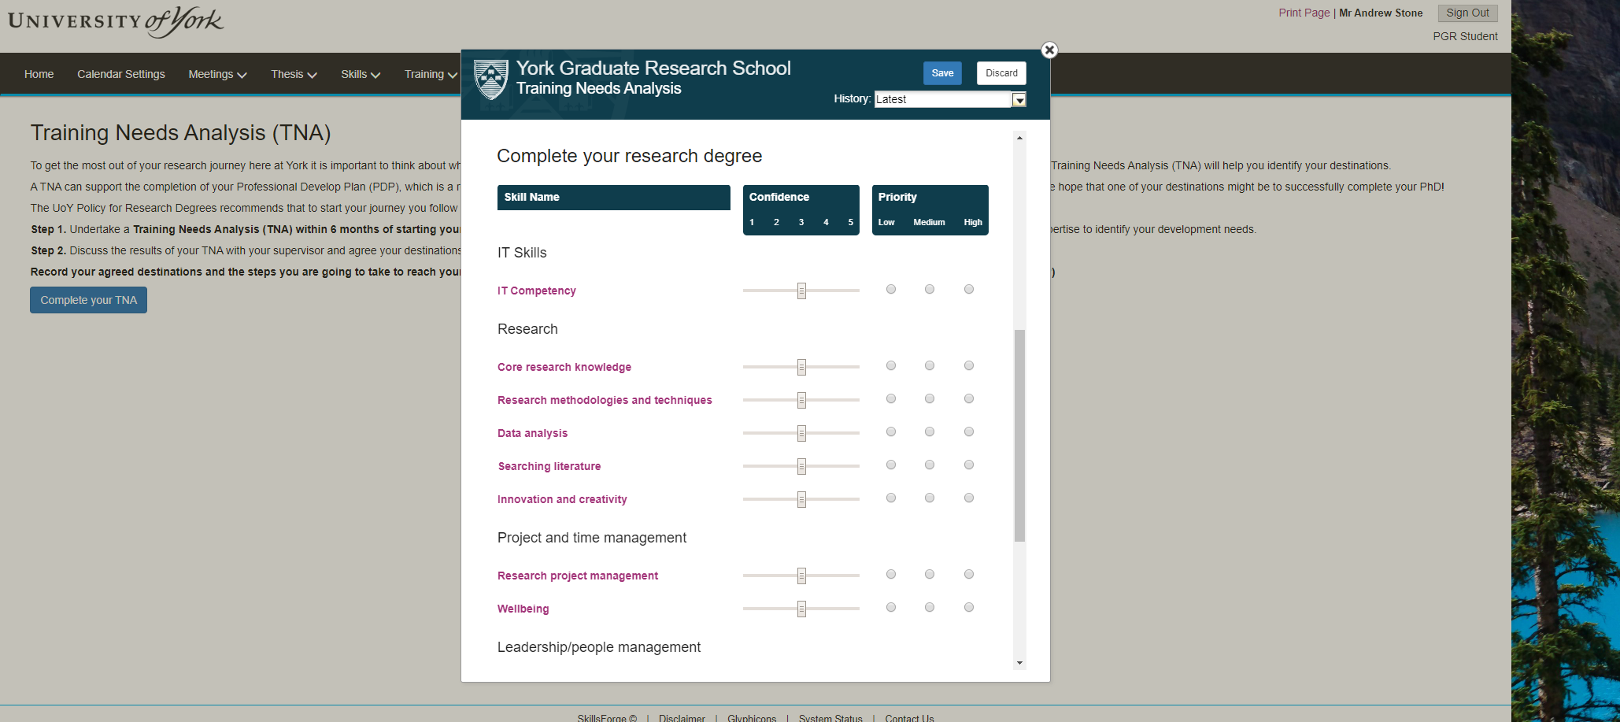

Slide 18
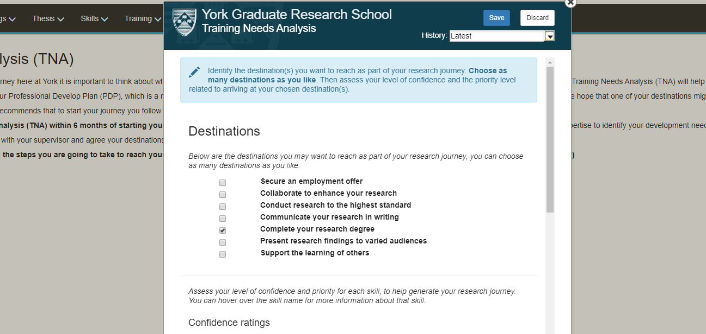

Slide 19
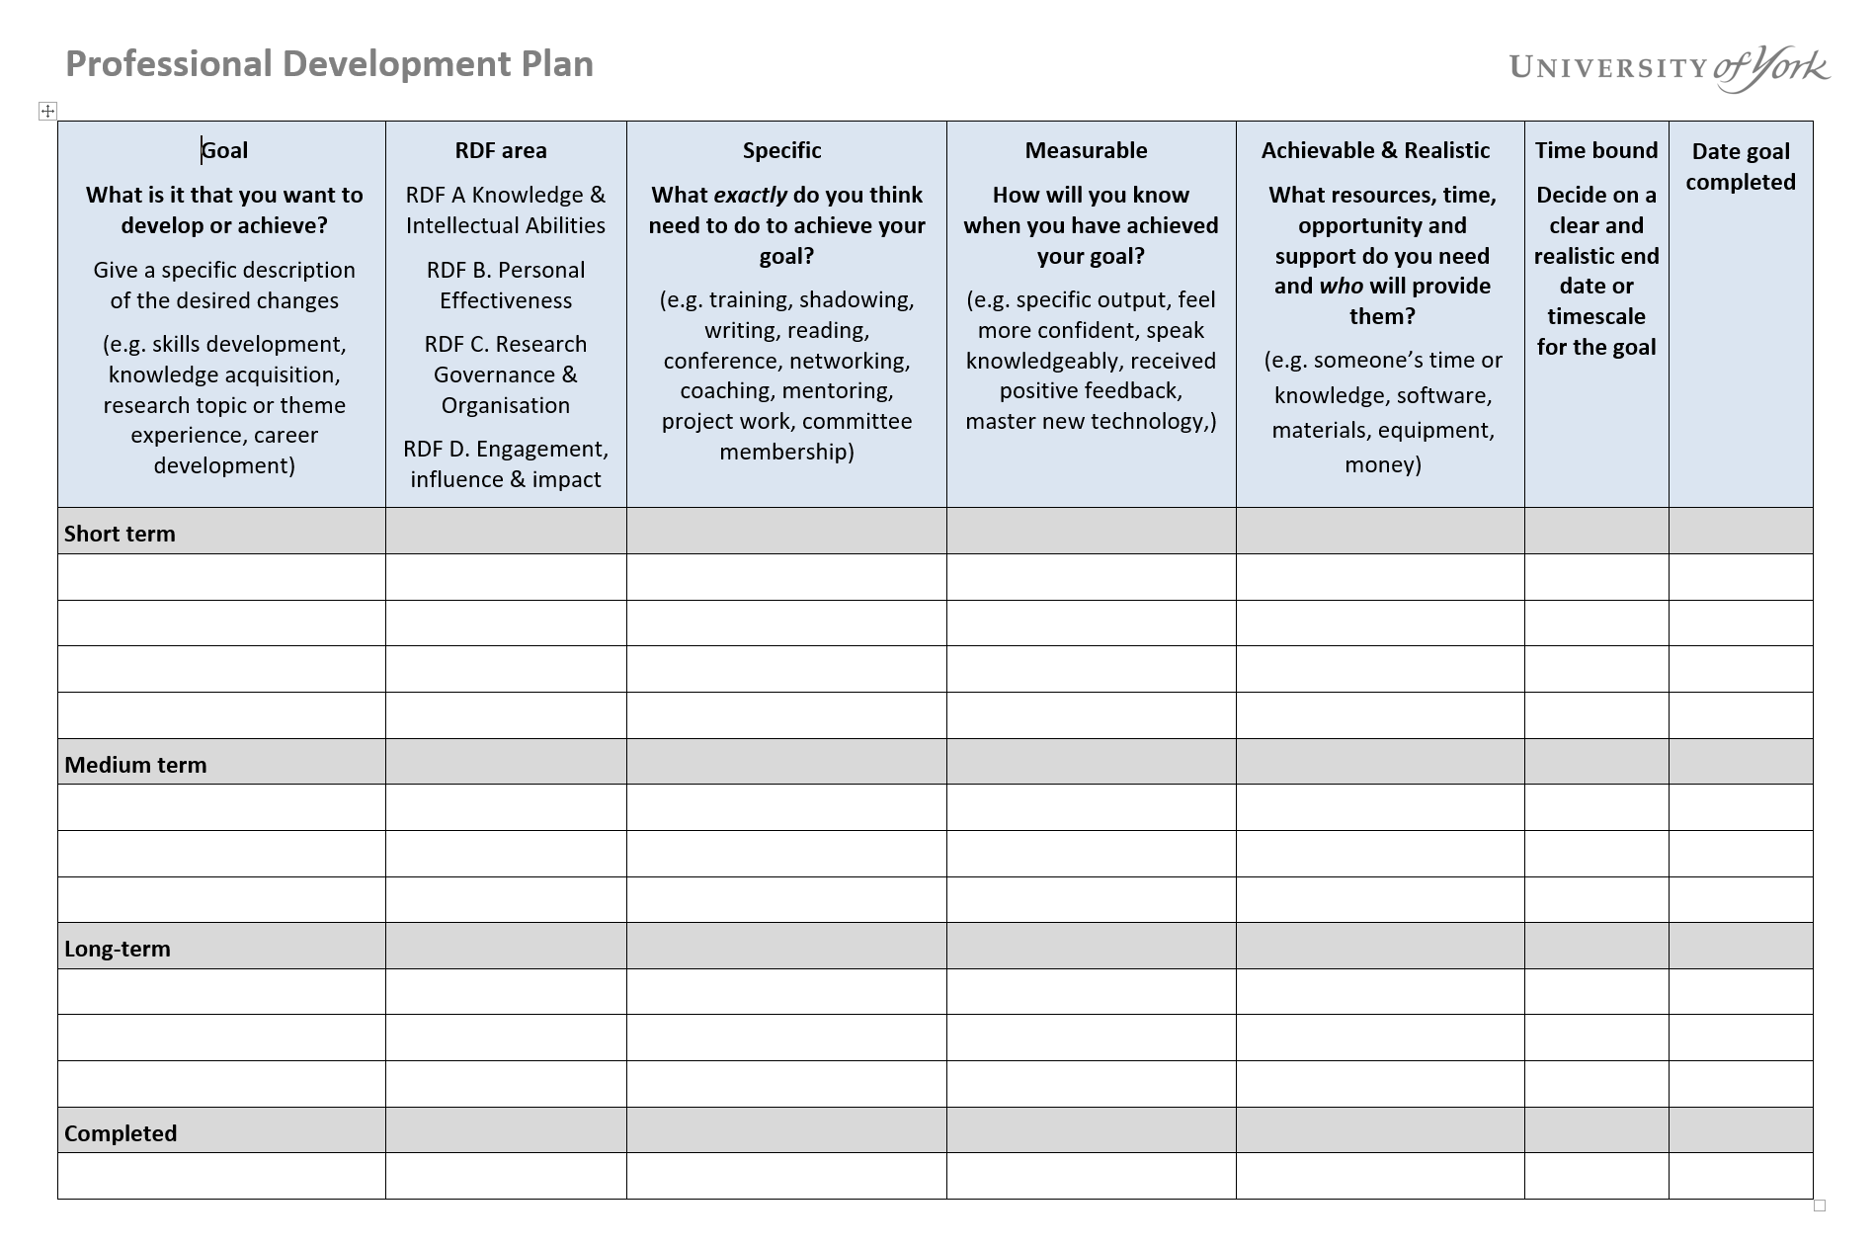

Slide 20
SMART Goals
Specific (What do I want to accomplish?)
Measurable (How much? How will I know it is accomplished?)
Achievable
Realistic
Time Bound

Slide 21
SMART Goals
Specific
Measurable
Achievable
Realistic
Time Bound
Public Engagement and Communication Experience
Take part in a public engagement activity to development my communication skills
When will I have the time to do this? How much time can I commit? When are the events happening? Will you run your own activity?
Complete in the next 6 months (or by next TAP meeting)

Slide 22
With your group:
Use the answers from your previous discussion to help each other write SMART goals
Specific (What do I want to accomplish?)
Measurable (How much? How will I know it is accomplished?)
Achievable
Realistic
Time Bound

Slide 23
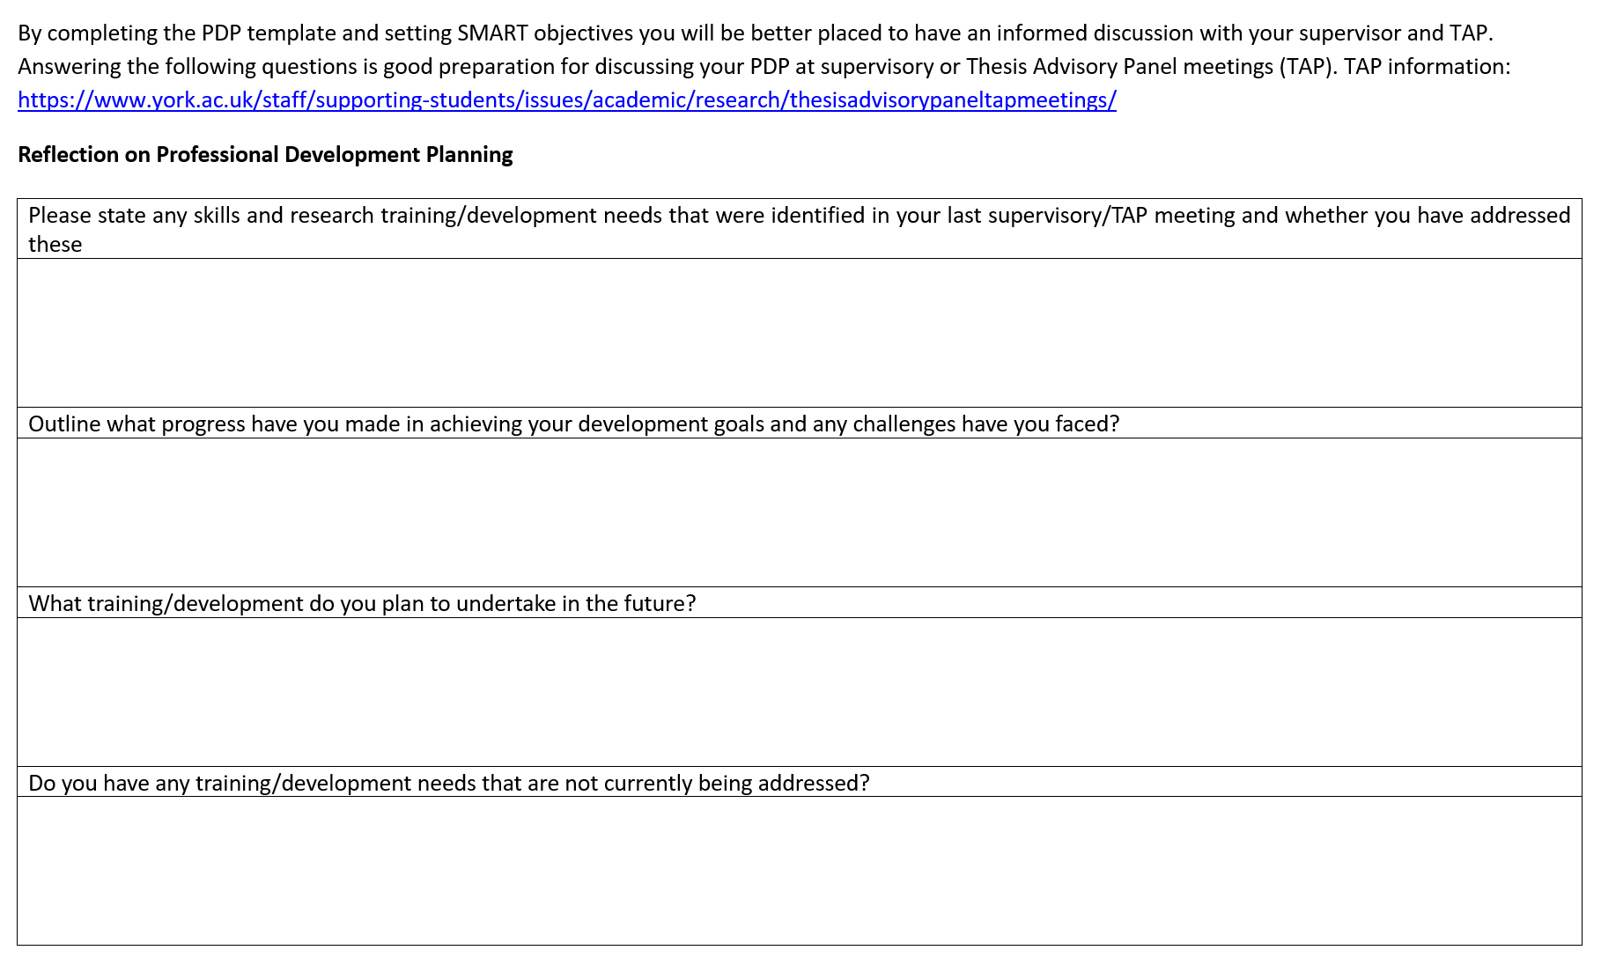

Slide 24
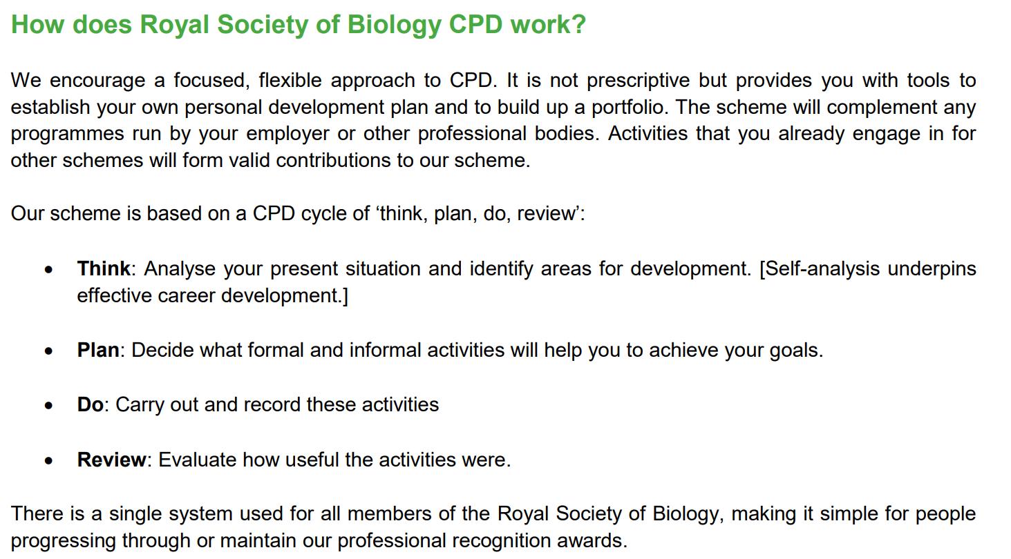

Slide 25
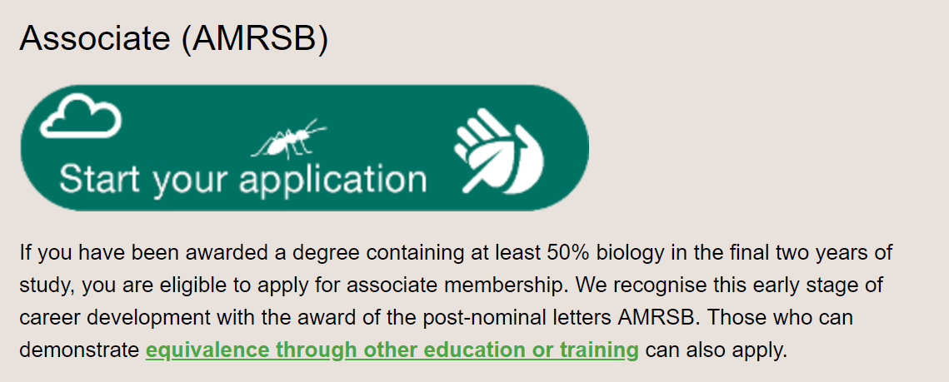

Slide 26
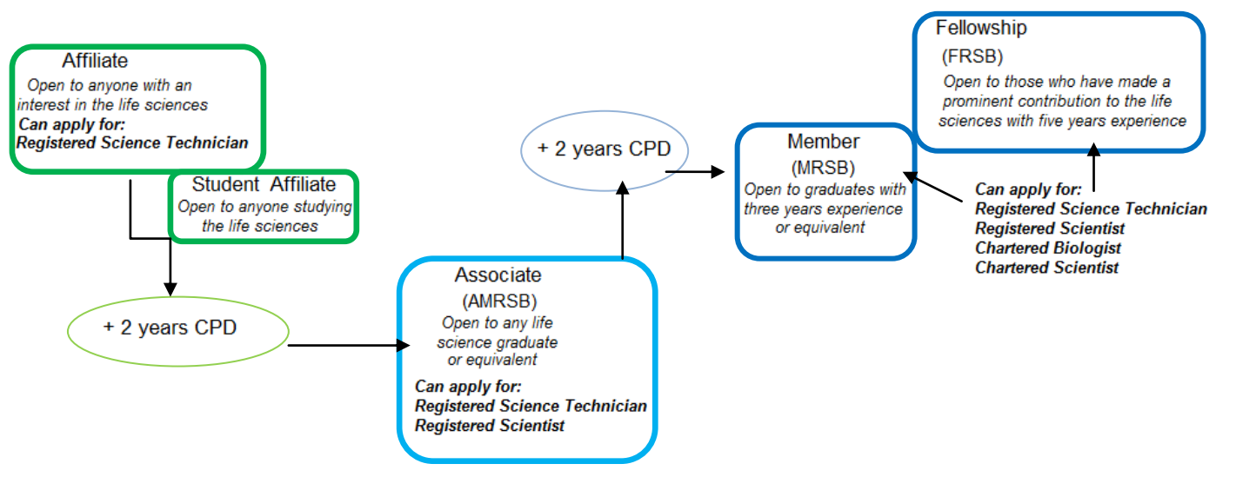

Slide 27
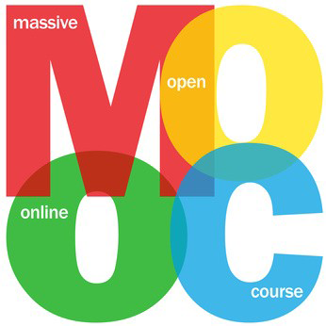
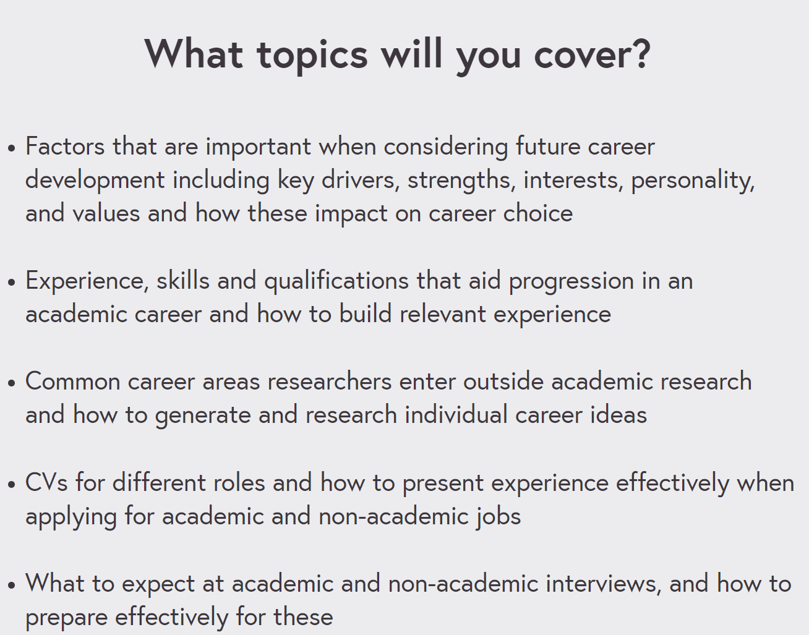

Slide 28
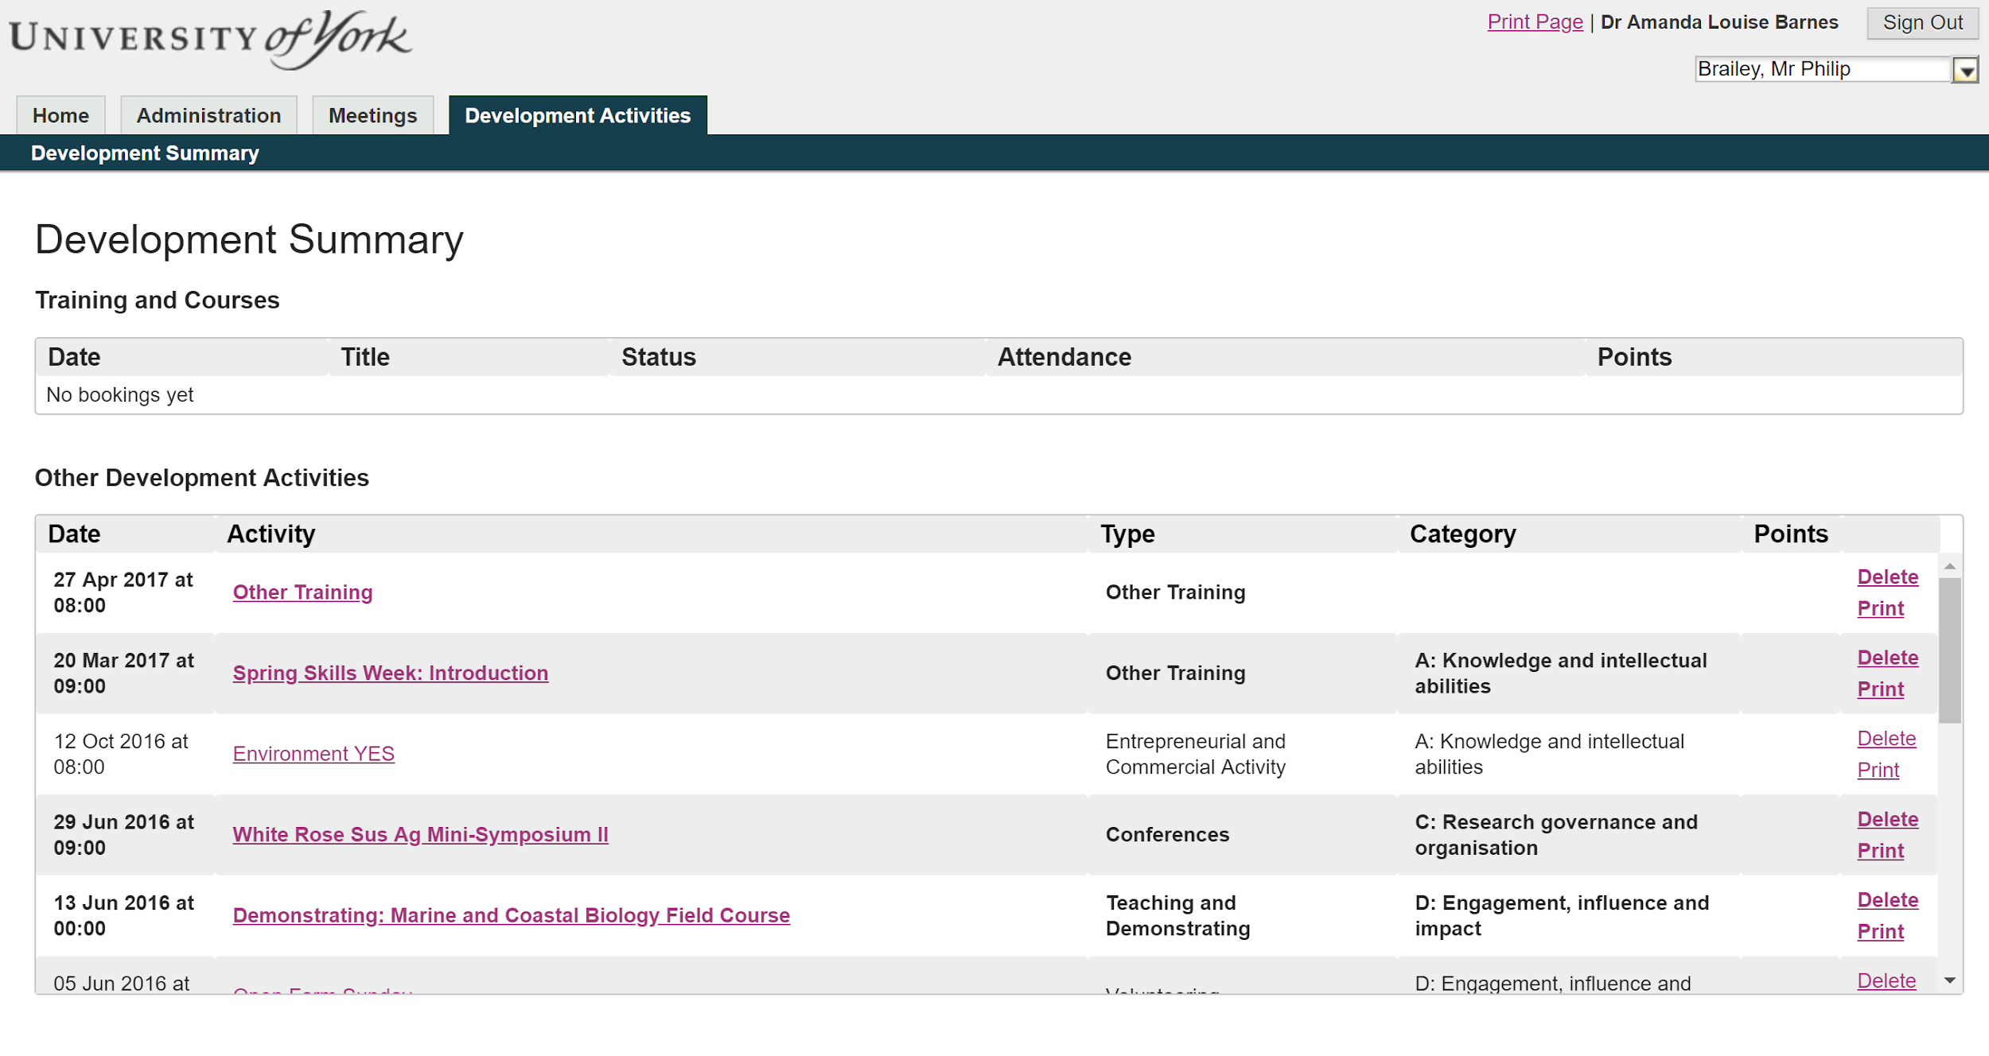
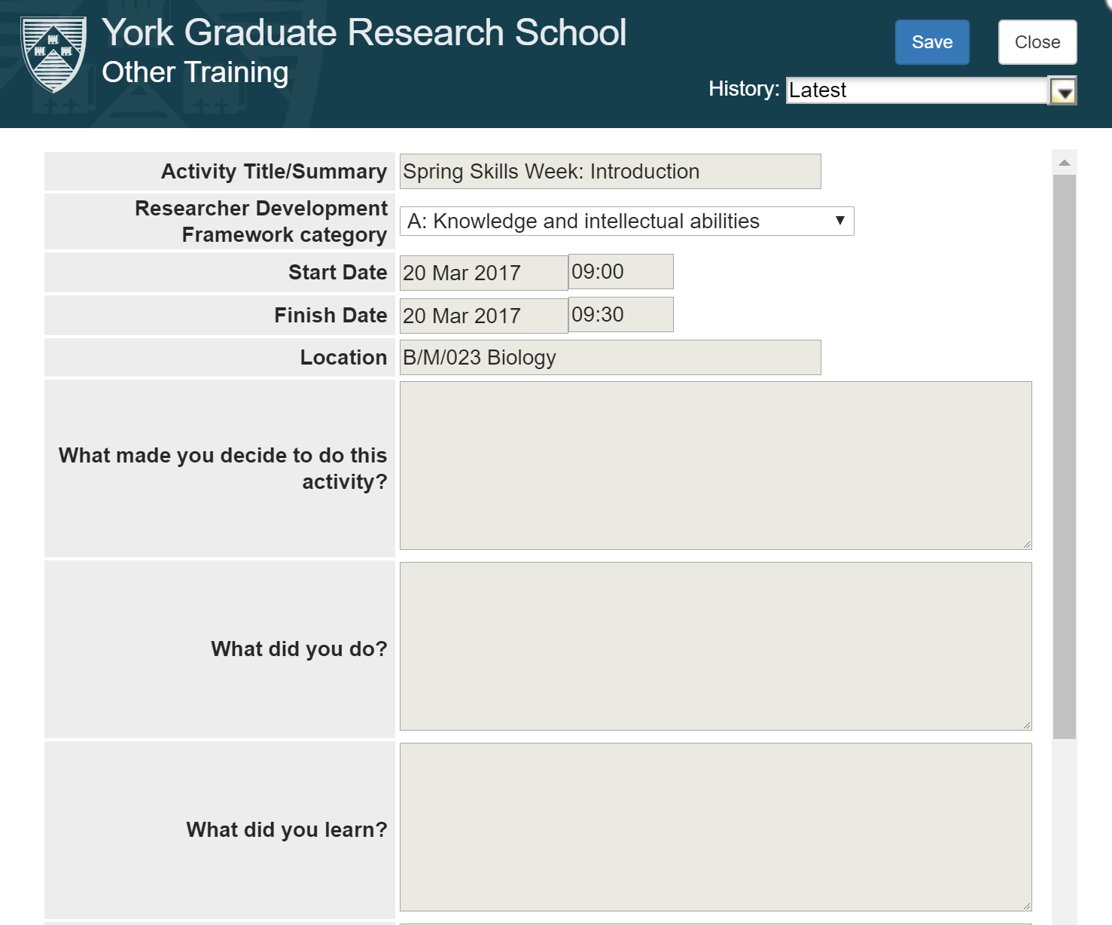

Slide 29
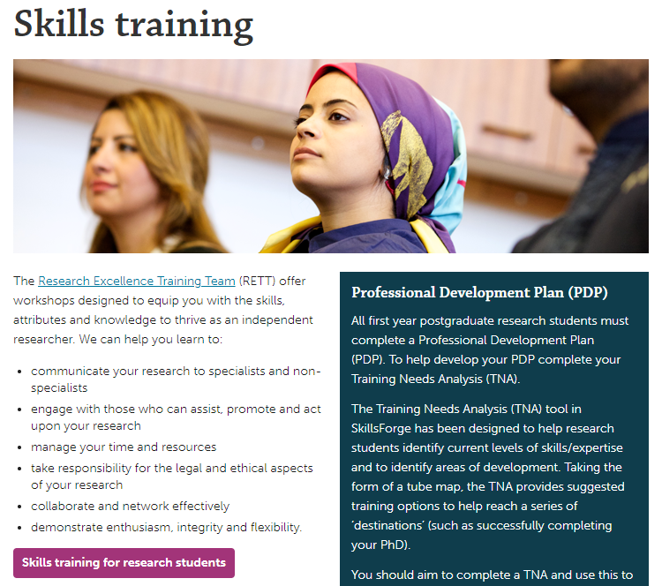
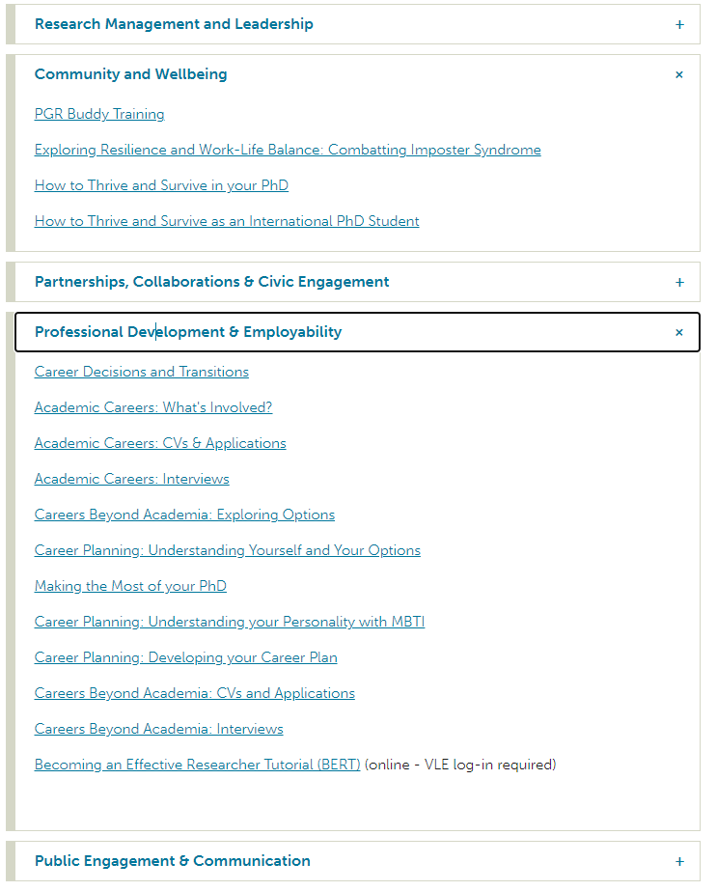
Research Excellence Training Team (RETT)

Slide 30
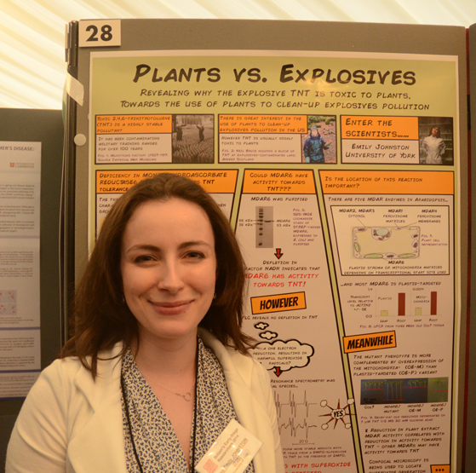
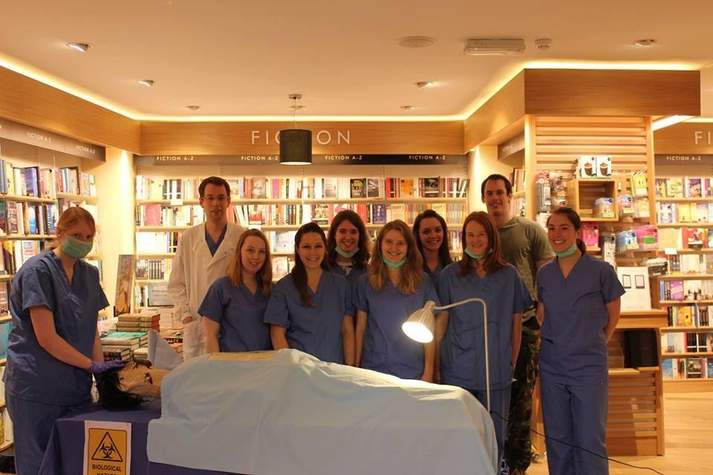
What have other students done?

Slide 31
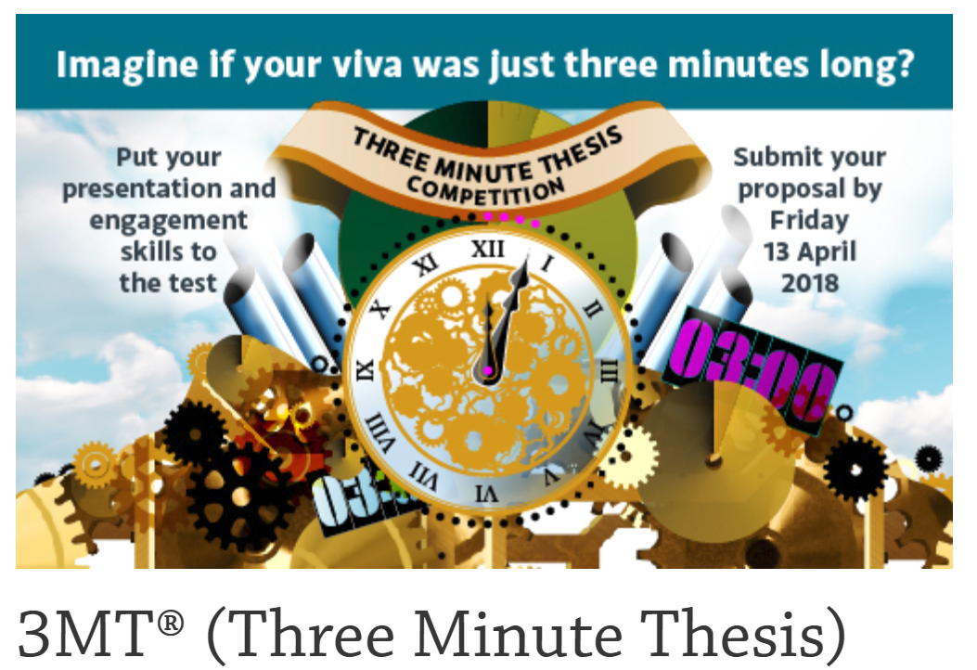
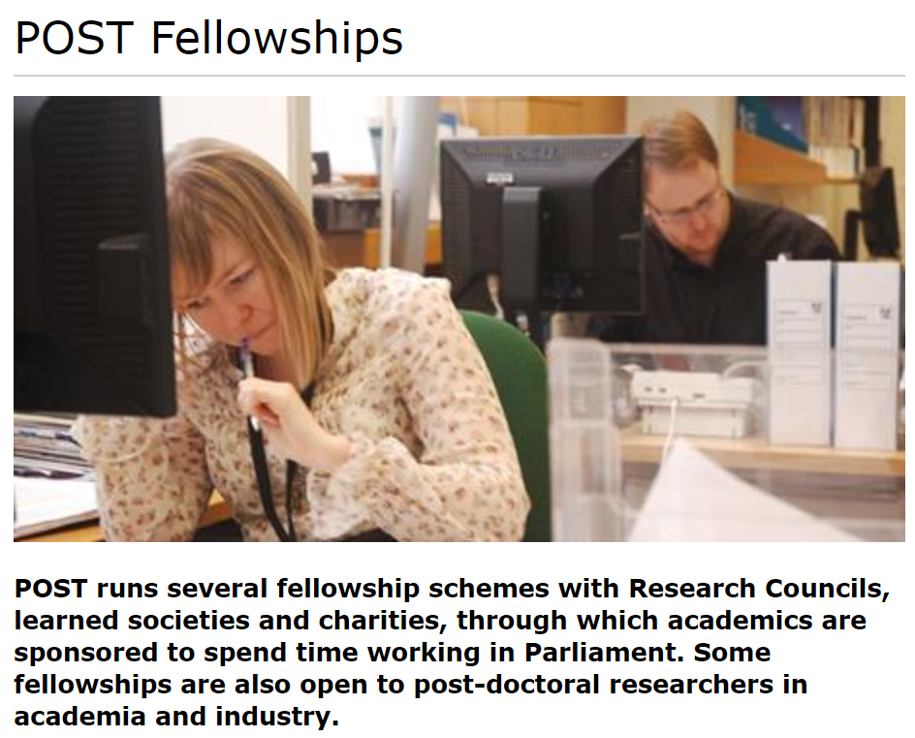
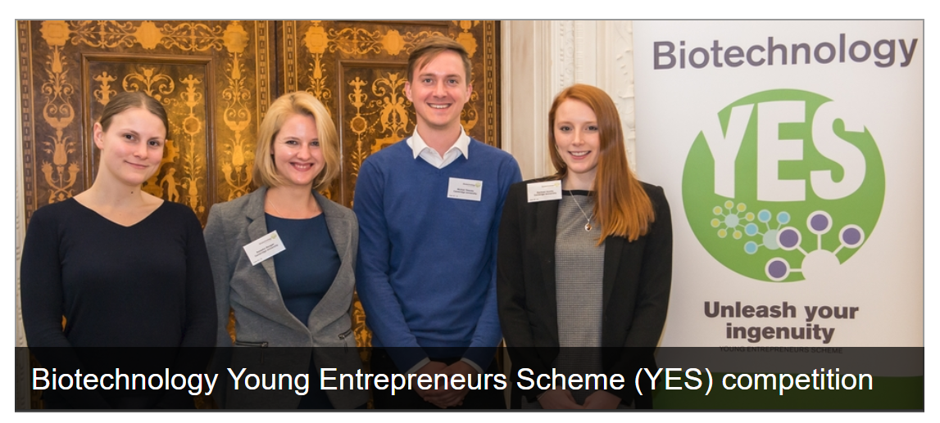
What have other students done?
Running departmental events/conferences
PhD Rep
Running Gradshare/ Speakeasy/ Social Events

Slide 32
What is expected of me?
Perform a Training Needs Analysis in the first 6 months of PhD and discuss with supervisor
Undertake a variety of training activities on research skills and professional development
Complete a Professional Development Plan and review and update throughout your PhD (this is required for FRP)
Towards the end of your PhD complete ‘Research Impact and Professional Development’ summary
Notes:
RIPD?

Slide 33
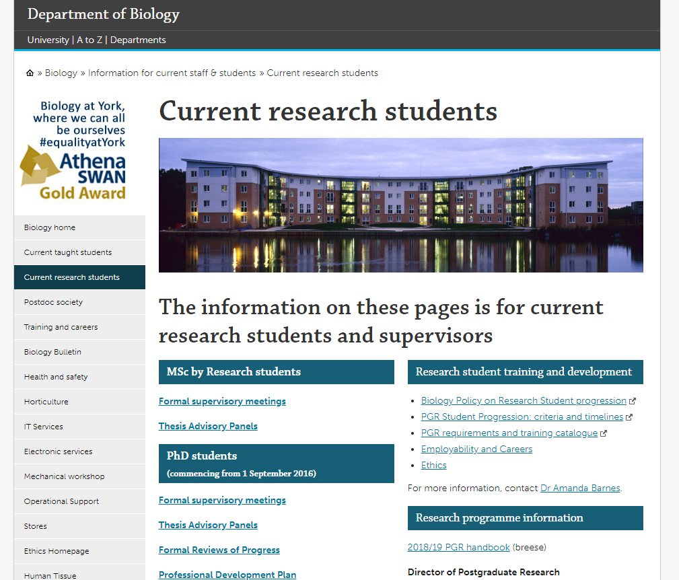

Slide 34
Oral Presentation Skills – Wednesday 31st March
Prepare a 5 minute research presentation with slides
This can cover your PhD research, another project you have worked on, or something else completely! (Final year UG project, Masters project, Year in Industry, Internship)
Your presentation will be recorded and you will receive questions and feedback from 2nd/3rd/4th year PhD students
10:00 - 12:30

Slide 35
Year 1: Poster Presentation (May 20th)
Year 2: Second Year Talk (March)
Final Year: Final Year Talk (May)

